Slide 1

Serverless

Slide 2
Lambda
Compute service which takes care of provisioning and managing servers. You upload your code.
Use cases:
Execute lambda based on an event trigger. Could be changes to S3 bucket or DynamoDB table
Can be run in response to HTTP/S requests on API GW
Lambda functions can call other lambda functions
Supported languages: Node.js, Java, Python, C#, Go

Slide 3
Price
Requests: First 1 million requests free/month
$.20 per 1 million requests there after
Duration: 0.00001167/GB/sec used. Time rounded up to nearest ms

Slide 4
Lambda features
Cheap
Scales out automatically not up. Memory may need to be updated for scaling up
No servers
Amazon echo using Lambda under the hood
Independent – 1 function = 1 event
AWS Xray used for debugging
Lambda can do things globally

Slide 5
API GW
Fully managed AWS service helps publish, maintain, monitor and secure APIs at any scale.
Acts as front door for apps to access data from back-end.
Can enable caching
CORS can relax same-origin policy for JS using multiple domains. Enforced by client
Log results to CW
Low cost and scales automatically

Slide 6

API advanced
Import API: using API GW Import feature from external definition file
Supports swagger 2.0 definition files
Swagger definition can be included in payload
API Throttling: limits to 10,000 steady state requests/sec, 5000 concurrent requests/sec
If exceeded, 429 too many requests error
5000 concurrent requests can be handled in a millisecond
Limits can be relaxed for an extra charge $$
Can be used as SOAP webservice pass through

Slide 7

Lambda versioning
Can publish different versions
Versions once published are immutable
Functions can be referred using ARN
ARN with version suffix for e.g. $LATEST is qualified ARN else it’s unqualified ARN
Changes can only be made to qualified ARN
Can split traffic using alias to different version
Cannot be done with $LATEST, create alias to latest

Slide 8


Step functions
Graphical console to visualize and arrange components as a series of steps
Step functions tracks each steps state which helps with debugging

Slide 9
X-ray
Collects data about requests your application serves
Provides tools to view that data
Helps gain insight to identify issues
Traces requests coming in, tracks downstream calls as well
Xray deamon listening on UDP, running on OS

Slide 10
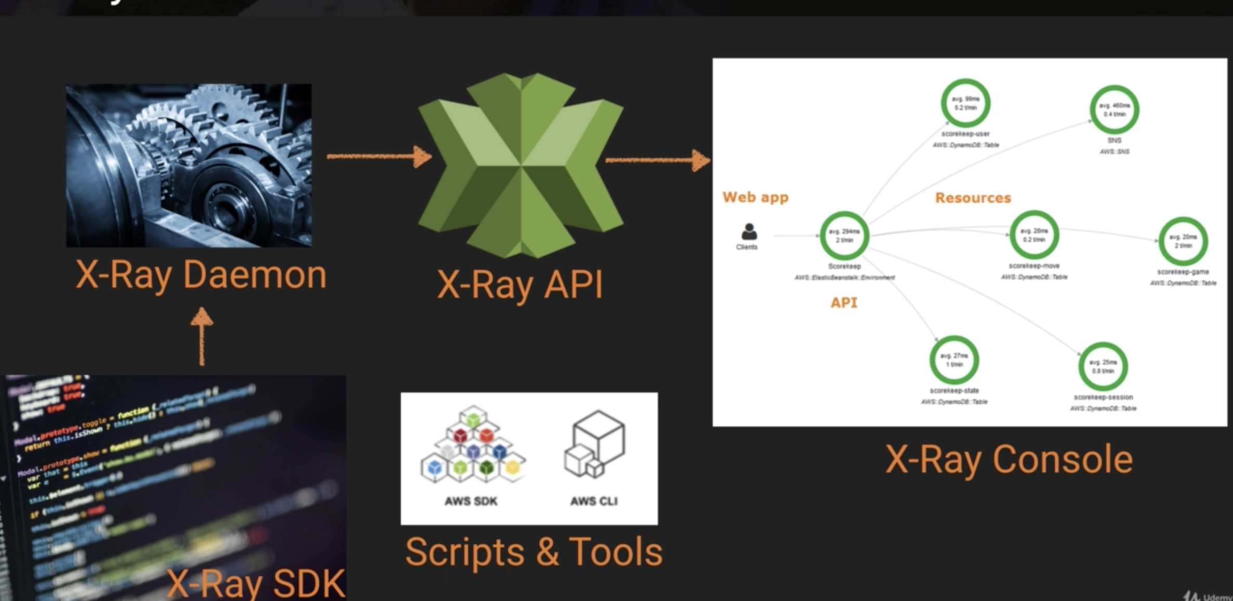

Slide 11
SDK
Add interceptors in code
Client handler to instrument AWS SDK
HTTP client

Slide 12
Integrations
ELB
Lambda
API GW
EC2
Elastic Beanstalk

Slide 13
Languages supported
Java
Go
.NET
Python
NodeJS
Ruby

Slide 14

More Stuff
Lambda runs in it’s own isolated environment
Lambda code is stored in S3 and encrypts it at REST
Lambda automatically reuses instances
Scales automatically
Inbound network connection blocked, TCP, UDP outbound supported
For sensitive information, use client-side encryption using AWS KMS, store resulting values in cyphertext
Lambda monitors Lambda functions, real-time metrics through Amazon CW, check duration metric, logs in CW, Invocations, Duration, Errors, DeadLetterErrors

Slide 15
More Stuff
CPU is proportionate to memory allocation
Subscribe to DynamoDB stream for trigger
SES receipt rule to deliver to lambda
CW Alarms send message to SNS, in turn triggers Lambda
HTTP invoke possible directly
Over HTTPS, needs API GW
Lambda Edge isn’t restricted to region, unlike lambda
Lambda retries 3 times, Kinesis retains data for 24 hour period
Use SQS or SNS for lambda topic
Lambda cannot associate with multiple VPCs
Lambda SG and NAT for outbound traffic needs to be configured

Slide 16
More Stuff
API GW: Websocket and HTTP API
HTTPS: provide your own custom cert for your domain on GW
Data types: JSON, XML
Backend – lambda, EC2, EB, Mock
Stages – are like tags, path to deployment accessibility
Stage variables are like env variables
Resource policy is attached to API – to give cross account access or CIDR blocks
Logging handled by CW
Secure login AWS Signature 4

